Slide 1
Welcome to my presentation

Slide 2
Gouri Biswas
I’D Number:22_0_37

Slide 3
MDG
Achieve Universal Primary Education
Improve Maternal Health
Develop a Global Partnership for Development
MDG
Eradicate Extreme Poverty and Hunger
Reduce Child Mortality
Combat HIV/AIDS, Malaria, and Other Diseases
Ensure Environmental Sustainability
Promote Gender Equality and Empower Women

Slide 4

Eradicate Extreme Poverty and Hunger
Halve the proportion of people living on less than $1.25 a day.
Achieve full and productive employment for all, including women and young people.
Halve the proportion of people who suffer from hunger.

Slide 5

Achieve Universal Primary Education
Ensure that all children, boys and girls alike, can complete a full course of primary schooling.

Slide 6

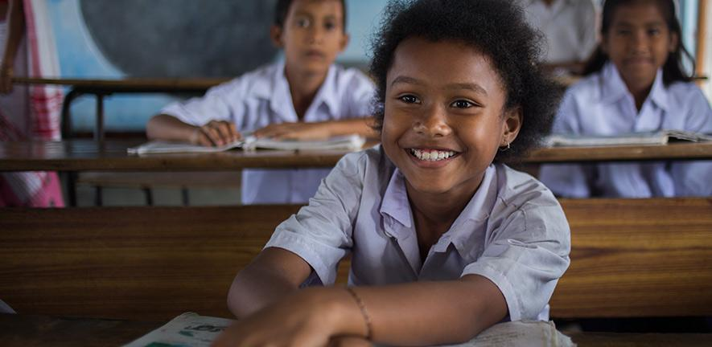
Promote Gender Equality and Empower Women
Eliminate gender disparity in primary and secondary education, preferably by 2005, and at all levels by 2015

Slide 7
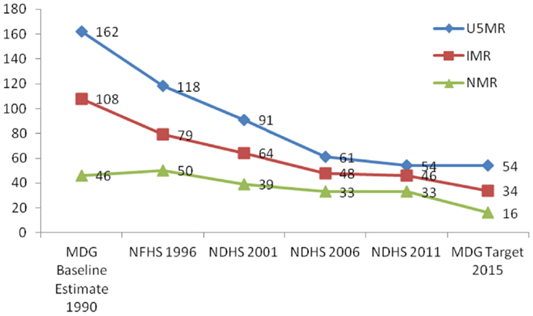
Reduce Child Mortality
The chart shows the rate of child mortality rate development till 2015 due to MDG

Slide 8
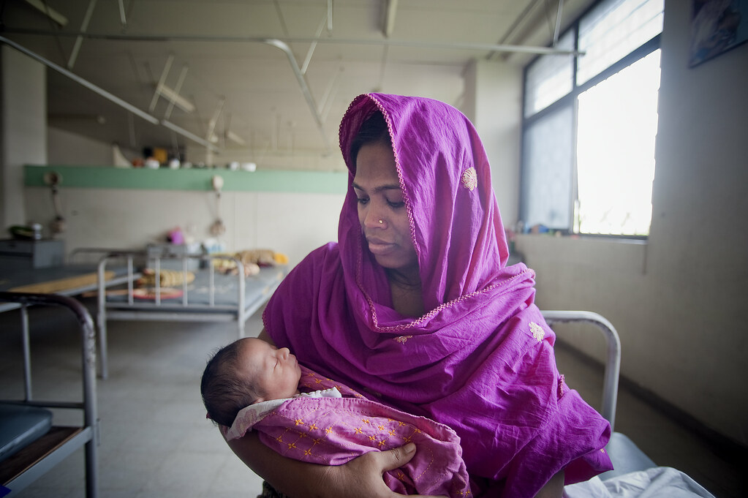
Improve Maternal Health
Reduce by three-quarters the maternal mortality ratio.
Achieve universal access to reproductive health.

Slide 9
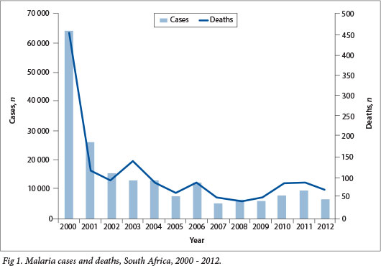

Combat HIV/AIDS, Malaria, and Other Diseases
Halt and reverse the incidence of malaria and other major diseases.
Halt and begin to reverse the spread of HIV/AIDS

Slide 10



Ensure Environmental Sustainability

Slide 11
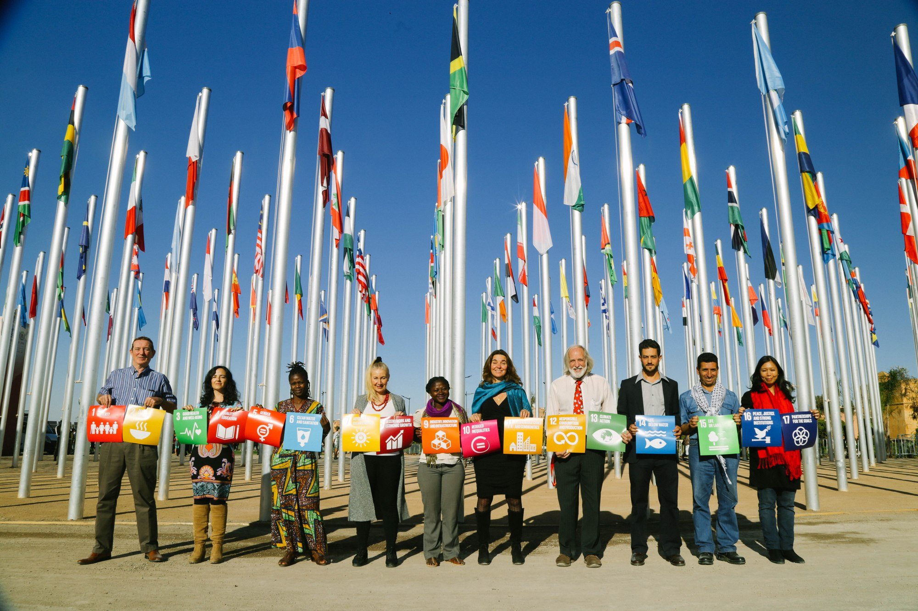
Develop a Global Partnership for Development
Address the special needs of least developed countries.
Enhance debt relief and provide affordable access to essential drugs and new technologies.
Develop an open, rule-based, predictable, non-discriminatory trading and financial system.

Slide 12
Thank You
THE END

